Slide 1

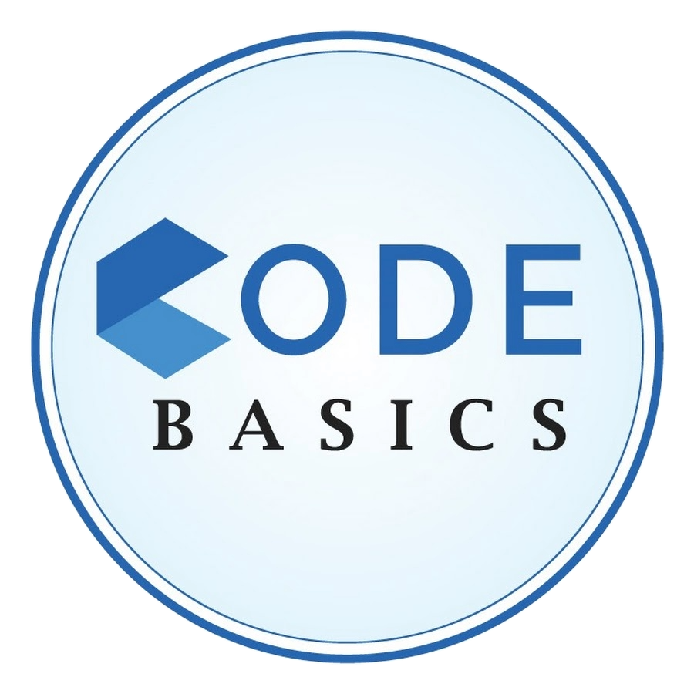
Telengana Government Growth Insights
Created By: Sutapa Ghosh

Slide 2


AGENDA
ABOUT PROJECT
INPUT DATASET
RESOLUTION
PRIMARY RESEARCH
SECONDARY RESEARCH

Slide 3

ABOUT PROJECT

Slide 4

.
ABOUT PROJECT
INTRODUCTION: Telangana is one of the fastest-growing states in India and one of the states with an open data policy.
OBJECTIVE : This project aims to analyze Telangana's growth across various sectors using real-time data, providing valuable insights to the government for informed decision-making.
TASKS : 1. There is a pdf consisting of Primary & Secondary questions instructions for which the business needs insights. 2. You can use any tool of your choice (Python, SQL, Power BI, Tableau, Excel, PowerPoint).
3. Ensure that all the insights are appropriately visualized and mapped on the Telangana map.

Slide 5

ABOUT DATASET

Slide 6
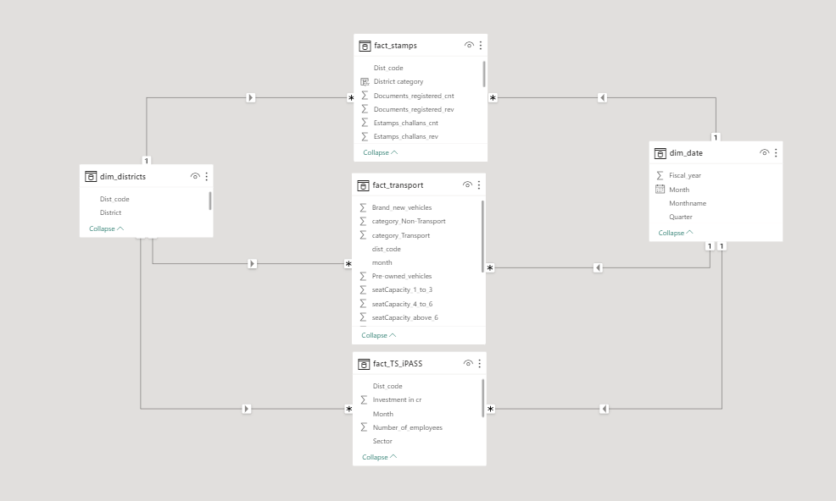
ABOUT DATASET

Slide 7
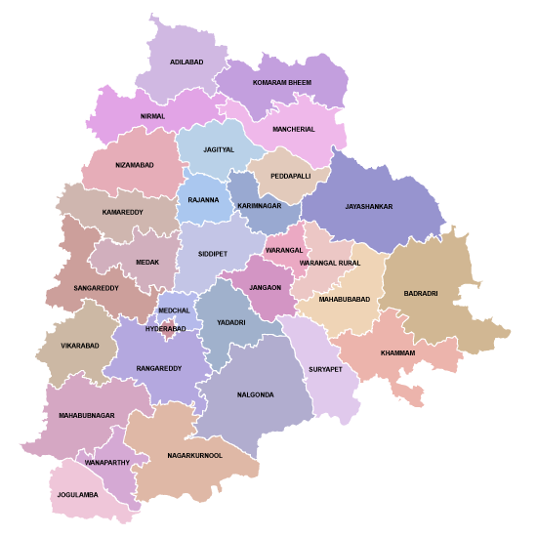
Districts Of Telengana

Slide 8
Business Sectors Of Telengana
SECTORS
Engineering
Wood and Leather
Textiles
Real Estate,Industrial Parks and IT Buildings
Plastic and Rubber
Paper and Printing
SECTORS
Cement, Cement & Concrete Products
Food Processing
Pharmaceuticals and Chemicals
Granite and Stone Crushing
Agro based incl Cold Storages
Electrical and Electronic Products
R&D
SECTORS
Fertlizers Organic and Inorganic
Beverages
Solar and Other Renewable Energy
Others
Thermal Power Plant
Automobile
Industrial Parks and IT Buildings

Slide 9
PRIMARY RESEARCH

Slide 10
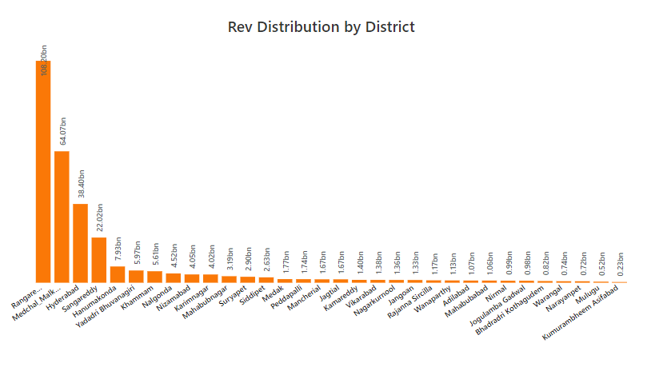
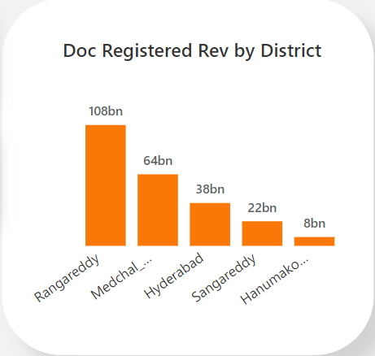
OUTCOME
QUERY 1
How does the revenue generated from document registration vary across districts in Telangana? List down the top 5 districts that showed the highest document registration revenue growth between FY 2019 and 2022.

Slide 11
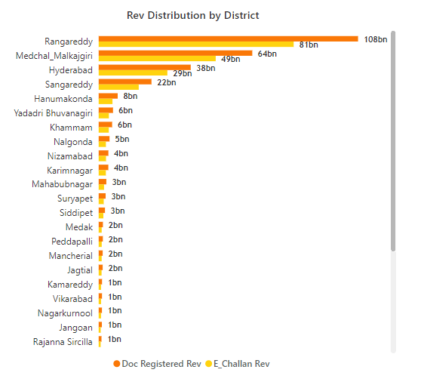
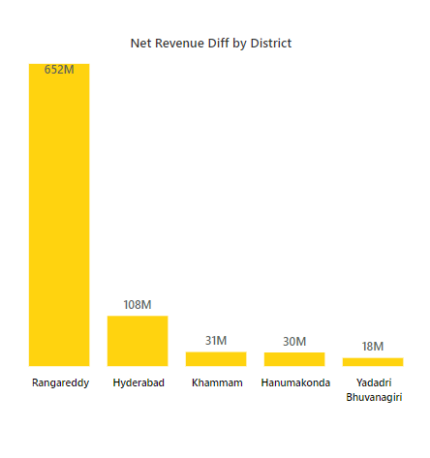
OUTCOME
QUERY 2
How does the revenue generated from document registration compare to the revenue generated from e-stamp challans across districts?
List down the top 5 districts where E-stamps revenue contributes significantly more to the revenue than the documents in FY 2022?
Net Revenue : ( E-stamp Rev – Registration Rev)

Slide 12
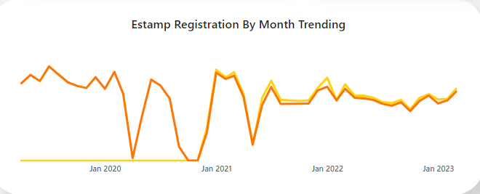

OUTCOME
QUERY 3
Is there any alteration of e-Stamp challan count and document registration count pattern since the implementation of e-Stamp challan? If so, what suggestions would you propose to the government?
E-Stamping was introduced in November 2020, leading to a significant increase in document registrations and E-stamping count in January 2021. However, this surge was followed by a decline in both E-Stamp and Document registration counts in May 2021, similar to the previous year's pattern.
Promotion and awareness campaign: After the implementation of this facility there was an immediate surge, so govt. should launch campaign to highlight the advantages of this to maintain the continued usage. Analyze the success factor: Investigate the reason for immediate surge in JANUARY 2021 and replicate the same strategy. Address the seasonal drop: Implementing strategy like promotion and incentive to mitigate the drop in MAY(Q2) 2021.
Enhance User Experience: They can focus on user experience by enhancing the streamline Process, Enhancing Digital platforms and giving user support. Digital Adoption incentive: Encourage Digital Adoption by giving discount and faster and hustle free processing.

Slide 13
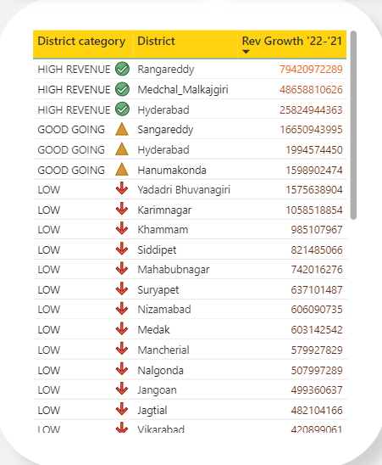
OUTCOME
QUERY 4
Categorize districts into three segments based on their stamp registration revenue generation during the fiscal year 2021 to 2022.
HIGH REVENUE : TOTAL REV ‘2022-’2021 > 2 Billion GOOD GOING : TOTAL REV ‘2022-’2021 > 500 Million
LOW : TOTAL REV ‘2022-’2021 < 500 Million
TOTAL REVENUE : (ESTAMP REV + REGISTRATION REV)

Slide 14
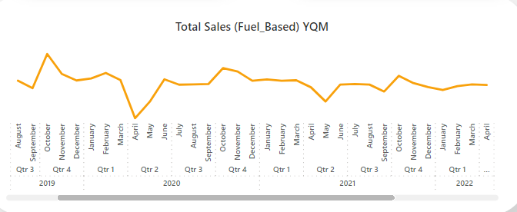
OUTCOME
QUERY 5
Investigate whether there is any correlation between vehicle sales and specific months or seasons in different districts. Are there any months or seasons that consistently show higher or lower sales rate, and if yes, what could be the driving factors?
Yes, there is weak correlation between vehicle sales and specific months or seasons in different districts as it shows high sales in OCTOBER month of every year (2019,2020,2021).
FOR DIESEL AND PETROL FUEL TYPE
SALES WERE HIGH : Oct month of (2019,2020,2021),Jan 2022 SALES WERE LOW : Sept 2019,May 2021,Sept 2021,Nov 2022
REASONS
PEAK IN OCTOBER : This can be caused by factors like festive seasons ,new launches. PEAK IN JANUARY : This can be caused by Economy recovery and launching new models, as offices are returning to the office culture many people are preferring own vehicle.
FOR ELECTRIC FUEL TYPE
LOW IN BEGINNING: This can be caused by factors like limited electric vehicle infrastructure & customer hesitancy. PEAK IN 2021(Q2) : This uptick can be caused by Economy recovery, growing environmental awareness, improvements in EV infrastructure, availability of more charging networks etc.
FOR OTHERS FUEL TYPE
LOW IN BEGINNING: This can be caused by factors like global pandemic impact on economic condition and supply chain. PEAK IN 2021(Q2) : This uptick can be caused by Economy recovery.

Slide 15
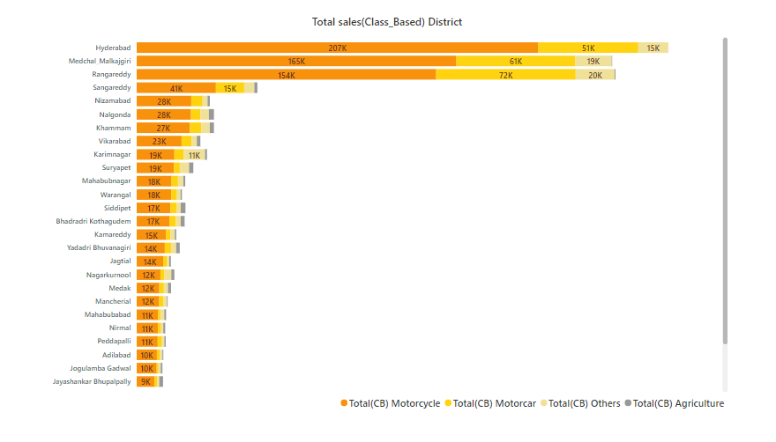
OUTCOME
QUERY 6
How does the distribution of vehicles vary by vehicle class (Motor Cycle, Motor Car, Auto Rickshaw, Agriculture) across different districts?
Are there any districts with a predominant preference for a specific vehicle class? Consider FY 2022 for analysis.
Yes, the Clustered bar chart does suggest that there is a trend of Predominant Preference for motorbikes across all the districts.
Cost-Effective Transportation: Motorbikes are often more affordable than cars and offer a cost-effective mode of transportation for individuals and families.
Traffic Congestion: In urban areas, including districts in Telangana, traffic congestion can be a significant issue. Motorbikes are more convenient and can navigate through traffic more easily than larger vehicles.
Rural Areas and Agriculture: Telangana has a significant rural population engaged In agriculture. Motorbikes are often used for agricultural purposes, such as transporting farm produce, accessing remote fields, and conducting other farming-related activities.

Slide 16
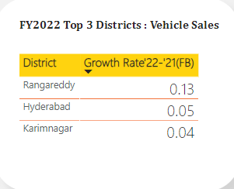
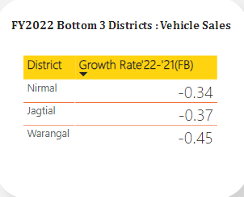
OUTCOME
QUERY 7
List down the top 3 and bottom 3 districts that have shown the highest and lowest vehicle sales growth during FY 2022 compared to FY 2021? (Consider and compare categories: Petrol, Diesel and Electric)

Slide 17
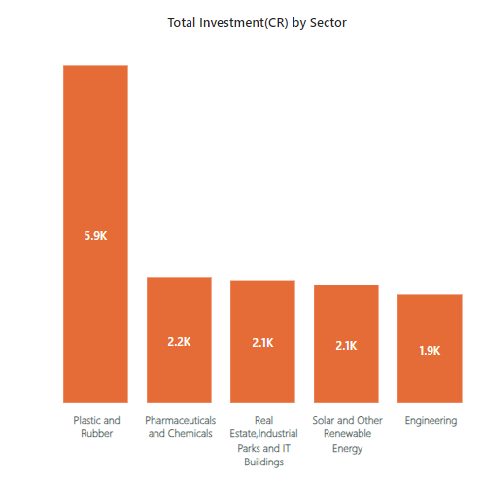
OUTCOME
QUERY 8
List down the top 5 sectors that have witnessed the most significant investments in FY 2022.

Slide 18
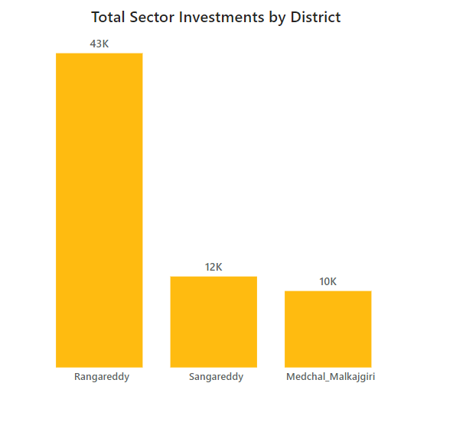
OUTCOME
QUERY 9
List down the top 3 districts that have attracted the most significant sector investments during FY 2019 to 2022?
What factors could have led to the substantial investments in these particular districts?
Mainly this districts have attracted Real estate & industrial park, Plastic rubber, Phermaceuticals & chemicals, Engineering this sectors during 2019 to 2022.
FACTORS FOR THIS SUBSTANTIAL INVESTMENT
Proximitiy to Hydrabad : Rangareddy and Medchal both are located close to the capital city Hydrabad ,which is a major urban centre and IT hub.Proximity to a urban centre & pool of skilled people can attract various industries. Govt. initiative : Since Telengana govt. has implemented TS_IPASS, it has attracted a large no. of new business like plastic, brevarage,textile and many more. This TS_Ipass system made it really easy for businesses to get approvals, encouraging them to invest.
Infrastructure & Resources : There is availability of infrastructure & resources like land, power supply, water. It also can influence the investment decision.
Engineering colleges : Proximity to various colleges also ensures about the skilled people for jobs

Slide 19
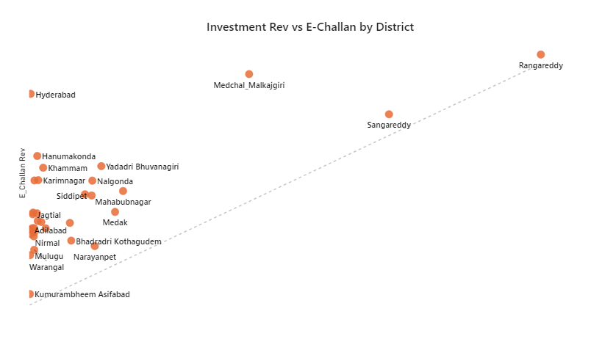
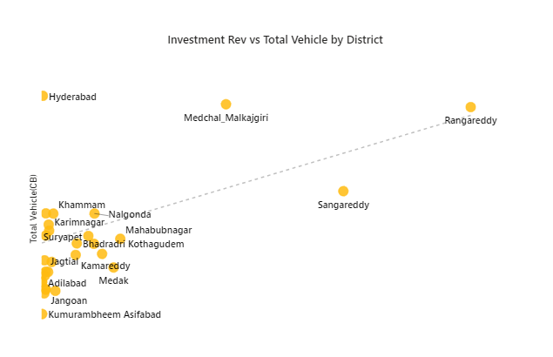
Is there any relationship between district investments, vehicles sales and stamps revenue within the same district between FY 2021 and 2022?
QUERY 10
OUTCOME

Slide 20
Is there any relationship between district investments, vehicles sales and stamps revenue within the same district between FY 2021 and 2022?
QUERY 10
INSIGHTS
Yes, there is a latent correlation between E-challan Revenue , District Investment, Vehicle Sales within few districts of Telengana Between the FY 2021 and FY 2022.
District Investment : Rangareddy,Sangareddy,Medchal,Mahabubnagar,Kamareddy these Districts have experienced higher sector investment and increased business activities often witness a rise in vehicle sales or any property sales, which can lead to higher E-challan revenue due to increased demand.
Vehicle sales: The Telangana government's TS_IPASS implementation has stimulated the arrival of numerous businesses in sectors. These businesses are expanding, resulting in a growing workforce. Many employees are opting for two-wheelers or vehicles for commuting, leading to a notable increase in E-challan revenue.
E-challan Revenue: Rangareddy,Sangareddy,Medchal,Hydreabad these Districts have experienced higher E-challan Revenue. When E-challan revenue increases, governments have more funds available for various other sector projects that can attracts more investments , such as infrastructure, healthcare, Development and many more.

Slide 21

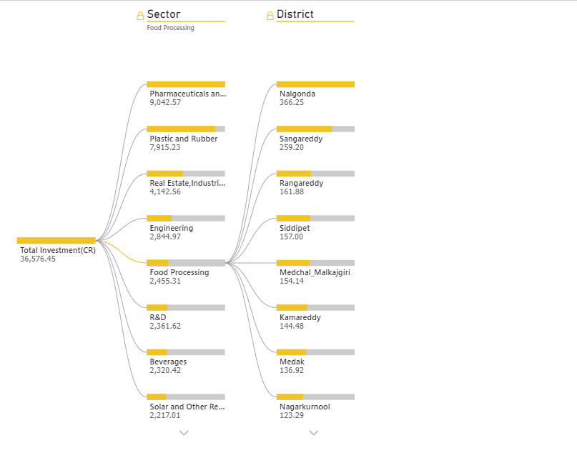
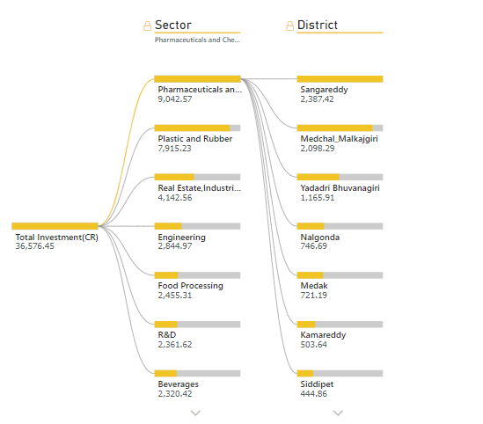
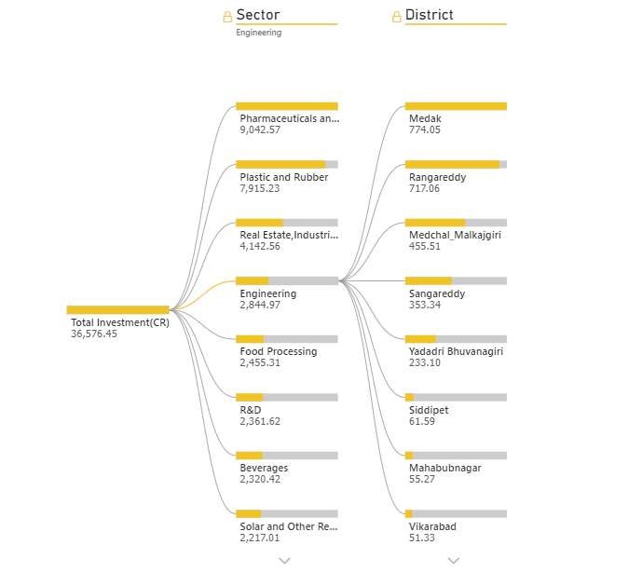
QUERY 11
Are there any particular sectors that have shown substantial investment in multiple districts between FY 2021 and 2022?
OUTCOME
Sector: Pharmaceuticals and chemicals
Sector: Engineering
Sector: Food Processing

Slide 22

Are there any particular sectors that have shown substantial investment in multiple districts between FY 2021 and 2022?
QUERY 10
INSIGHTS
Yes, During the fiscal years 2021 and 2022, several sectors have exhibited significant investment across multiple districts.
SECTORS THAT HAVE SHOWN SUBSTANTIAL INVESTMENT
Pharmaneuticles and chemicals: This sector has invested in 25 districs including sangareddy,Medchal_markajgiri,Nalgonda. It has invested about 9042.57 CR.Top districts are sangareddy, Medchal_markajgiri, Yaddari_bhuvangiri,Nalgonda,Medak, Kamareddy,Siddipet.
Engineering : This sector has invested in 31 districs including Medak, Sangareddy,Rangareddy. It has invested about 2845 CR.Top districts are Medak,Rangareddy,Sangareddy, Medchal_markajgiri, Yaddari_bhuvangiri, Siddipet, Mehboobnagar.
Food Processing: This sector has invested in all the districs including Sangareddy, Medchal_markajgiri, Nalgonda. It has invested about 2455.31 CR. Top districts are Rangareddy, Sangareddy, Medchal_markajgiri, Kamareddy, Medak, Nagarkurnool, Yaddari_bhuvangiri.

Slide 23
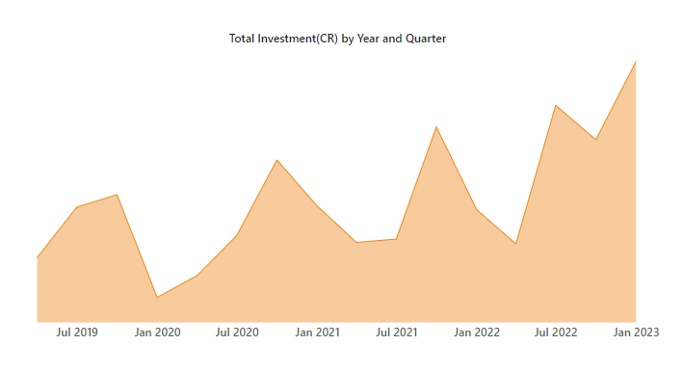
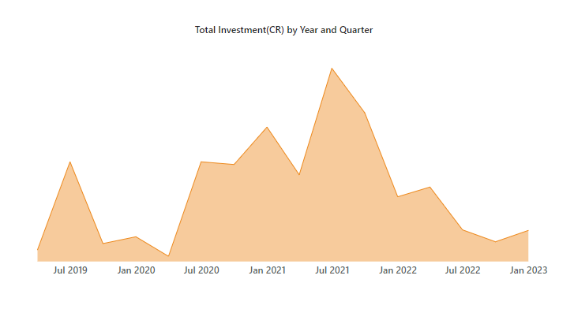
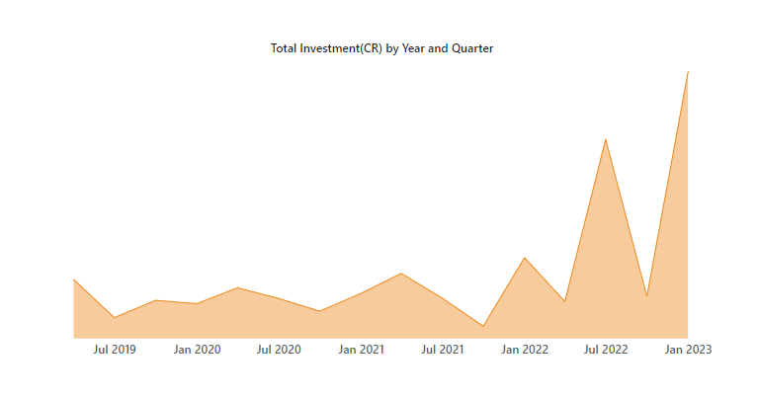
QUERY 12 A
Can we identify any seasonal patterns or cyclicality in the investment trends for specific sectors?
OUTCOME
Sector: Pharmaceuticals and chemicals
Sector: Electrical & electronic Products
Sector: Food Processing
ss
ss
ss
Investments were high on 2019,2020,2021 (Q3)
Investments were high on 2019,2020,2021 (Q2)
Investments were high on 2019,2020,2021 (Q4) DEC

Slide 24
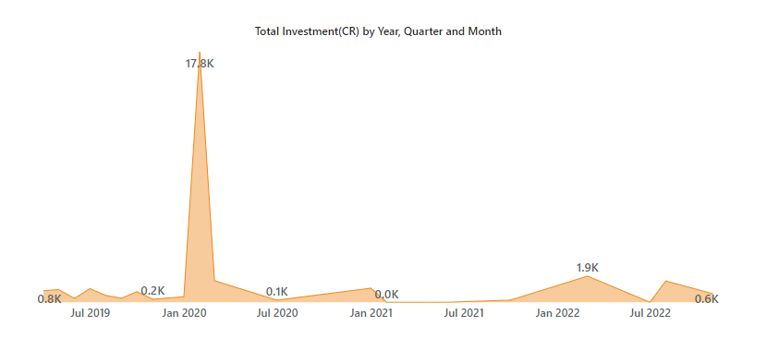
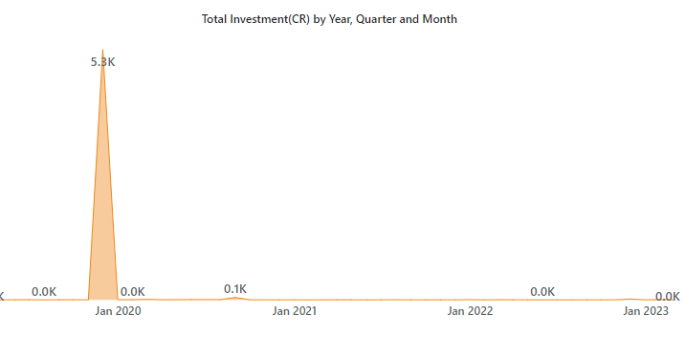
QUERY 12 B
Do certain sectors experience higher investments during particular months?
OUTCOME
Sector: Real Estate, Industrial Parks, IT Buildings
Sector: Fertilizers organic and inorganic

Slide 25
SECONDARY RESEARCH

Slide 26
OUTCOME
QUERY 1
TOP 5 DISTRICTS TO BUY COMMERCIAL PROPERTIES
What are the top 5 districts to buy commercial
properties in Telangana? Justify your answer.
Rangareddy
Sangareddy Medchal malkajgiri Hydrabad Hanumakunda
REASONS
Economic Growth: These cities are experiencing high economic growth, attracting businesses and investors looking for commercial spaces to establish or expand their operations.
Infrastructure Development: Investment in infrastructure projects, such as road networks, public transportation, and business parks, can make these cities more appealing for commercial property buyers.
Proximity to Hydrabad : Being near major urban centers like Hyderabad makes cities like Sangareddy, Medchal Malkajgiri, and Hanumakonda attractive to businesses. They can act as satellite hubs, providing access to larger markets without the congestion of a big city. Educational and Healthcare Facilities: The availability of quality educational and healthcare facilities in this cities can make them attractive for businesses and residents alike.

Slide 27
OUTCOME
QUERY 2
INITIATIVES WERE PUT INTO ENHANCE ECONOMIC GROWTH
What significant policies or initiatives were put into effect to enhance economic growth, investments, and employment in Telangana by the current government?
Introduced TS-IPASS Policy : The Telangana govt. had introduced a policy, the Telangana State Industrial Project Approval and Self-Certification System
(TS-iPASS ) . This policy aimed to streamline the process of obtaining various
clearances and approvals for setting up industries in the state.
Investor-friendly Policies: Telangana aimed to create a conducive business environment by offering incentives like land at competitive prices, power supply, and infrastructure support to attract investments from both domestic and international companies.
Introduced T-HUB & Various incentives: Hyderabad has a strong presence in the IT and ITES sectors. The government continued to support these industries through various incentives, infrastructure development, and skill enhancement programs. T-Hub, a startup incubator, was also established to promote innovation and entrepreneurship in the technology sector .
Introduced TSIIC : The Telangana State Industrial Infrastructure Corporation (TSIIC) is a government agency in the Indian state of Telangana. It plays a crucial role in promoting industrialization and economic development in the state. TSIIC is responsible for acquiring, developing, and maintaining industrial infrastructure such as industrial parks, estates, and zones.

Slide 28
Provide top 5 Insights to Telangana government for sustained growth in the next 5 years based on your analysis.
QUERY 3 A
Introduction of TS-iPASS
Introduction of E-stamping
Increased Vehicle Sales
Diversifiaction of Industries
Digitization Impact
Initiatives like 'TS-IPASS' simplify regulations, making it easier for businesses to start and operate. This attracts investments, both domestic and international, driving economic growth by fostering new businesses, industries, and infrastructure development.
E-stamping systems enhance efficiency and transparency by digitizing stamp duty collection and documentation, reducing paperwork, minimizing errors, and ensuring electronic transaction records. This not only aids revenue generation for governments but also reduces the risk of fraud, ensuring the correct amount of revenue for reinvestment in growth initiatives like infrastructure development.
Increased vehicle sales drive urbanization and stimulate infrastructure development, leading to improved connectivity between urban and rural areas. This, in turn, fuels urban planning initiatives, also fostering real estate development, ultimately contributing to economic growth.
TS-IPASS implementation has sparked substantial investments across various sectors in Telangana, spanning infrastructure,
real estate, food processing, pharmaceuticals, plastics, engineering, and more. This diverse investment landscape not only fuels economic growth but also enhances the state's resilience, making it less susceptible to economic fluctuations.
The increasing use of digital platforms for document registration and e-stamp issuance not only boosts revenue but also underscores the vital importance of digitization. This trend highlights the need for continuous investment in technology infrastructure, emphasizing technology's crucial role in shaping modern governance and the ongoing necessity for technological progress.

Slide 29
Provide top 5 recommendations to Telangana government for sustained growth in the next 5 years based on your analysis.
QUERY 3 B
Simplify Approvals and Boost Startups:
Fostering Global Investments:
Promotion & Awareness campaign:
Boosting Digital Adoption:
Integrated Urban Planning for Prosperity:
Keep the approval process in TS-iPASS efficient and friendly to investors. Additionally, introduce special measures to support small ,medium-sized businesses and various start-ups .This way, we can attract various businesses, create jobs, and promote economic growth in the state.
Actively engage with international markets, seek foreign direct investment, and participate in international trade agreements to attract global investments and expand economic opportunities..
Launch a promotion and awareness campaign to highlight the advantages of TS-IPASS & E-stamping process, which not only maintain the user engagement but also foster the economic growth.
Incentivize digital adoption by offering discounts and streamlining processing for a faster and hassle-free experience to simplify the TS-IPASS process, ultimately attracting more revenue
Develop holistic urban development plans that consider land use, transportation, housing, infrastructure, and environmental factors. This approach not only creates well-functioning, resilient cities but also attracts businesses, investments, and job opportunities, foster economic growth.

